Slide 1






Forecasting the Future:
Time Series Insights into Energy Consumption
Sustainable Consumption (1998–2022)
PRESENTED BY
Akhilesh Yadav (918)
Anjali Varma (931)
Sameera Khan (932)
Divya Jain (915)

Slide 2








Agenda
Introduction
Analysis
Objective
Forecasting
Methodology
Conclusion
Data Overview
1

Slide 3


Introduction
Electricity Demand Patterns in India
In a nation of over 1.3 billion people, where rapid economic growth and urbanization are reshaping the landscape, understanding the dynamics of energy consumption is paramount.
Throughout this presentation, we will embark on a journey to unravel the intricacies of electricity demand, examining historical patterns, identifying key drivers, and forecasting future trends. Our investigation aims to shed light on critical questions surrounding energy sustainability, infrastructure development, and policy formulation in the Indian context

Slide 4


Objectives
Method to Reduce Electricity Consumption
Forecast the Future Electricity Consumption

Slide 5




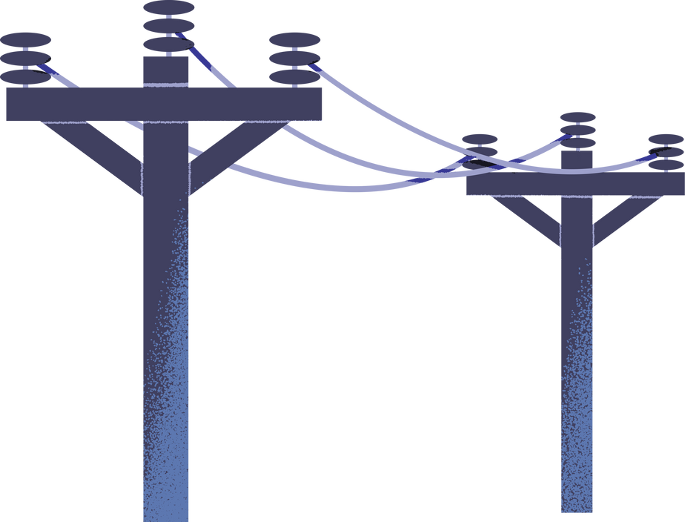
Methodology
Data Collection:
Software Used:
Secondary Data set are Taken as How much Primary Electricity use Per Year(in exajoules)
Statistical Methods:
Augmented Dickey-Fuller (ADF) test
Kwiatkowski-Phillips-Schmidt-Shin (KPSS)
Autoregressive Integrated Moving Average (ARIMA) Modelling

Slide 6
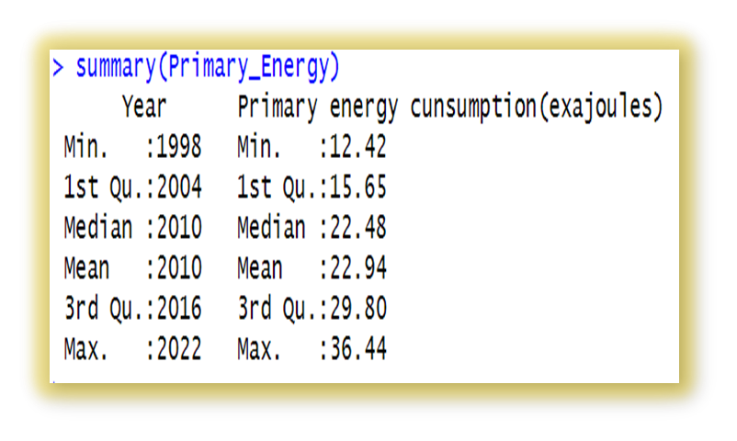
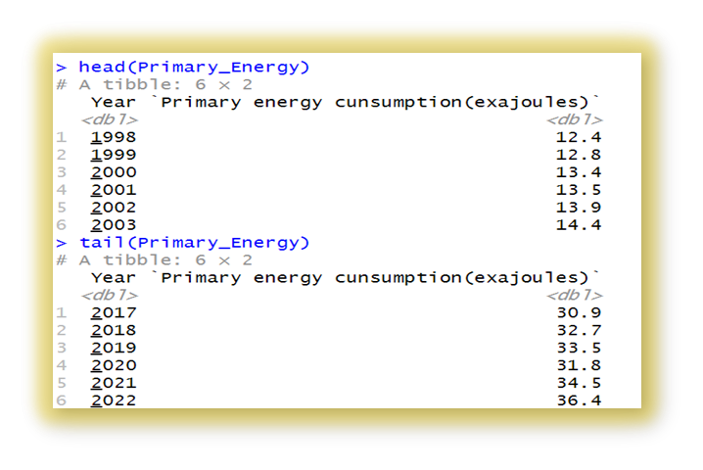
Data Overview
The dataset span from 1998 to 2022 and represent the Primary Electricity use Per Year (in exajoules) where ranges from minimum 12.42 to maximum 36.44 use electricity per year with median of 22.48 and mean is approximately is 22.94.

Slide 7
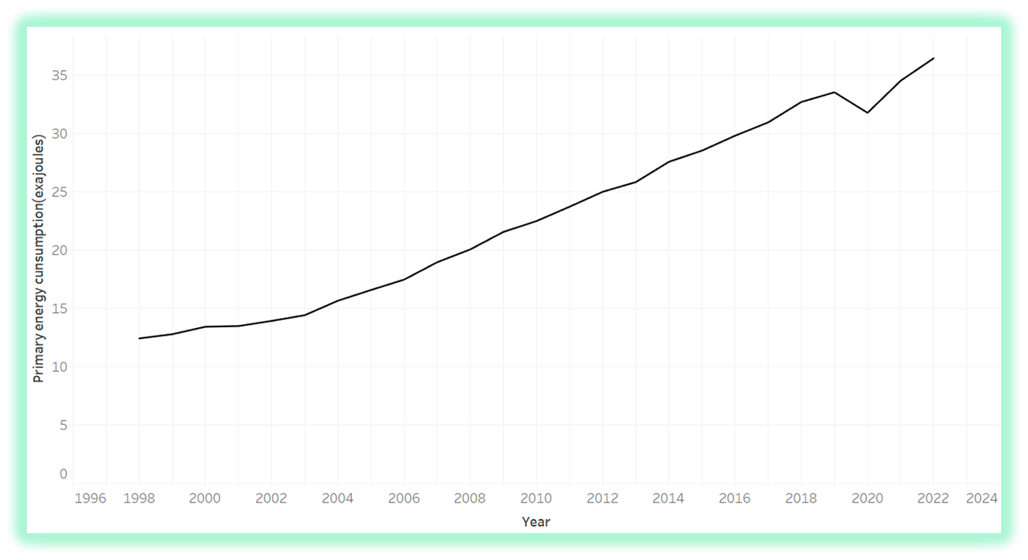
Data Visualization
STATIONARITY TESTING:
If either If ADF or KPSS test shows stationarity : Data may be suitable for ARIMA (Autoregressive Integrated Moving Average) model.
Augmented Dickey-Fuller (ADF) test
Kwiatkowski-Phillips-Schmidt-Shin (KPSS) test

Slide 8
Statistical Methods
Augmented Dickey-Fuller (ADF) Test:
Kwiatkowski-Phillips-Schmidt-Shin (KPSS) Test:
Hypothesis:
Hypothesis:
Null Hypothesis (H0): The time series data has a unit root and is non-stationary.
Alternative Hypothesis (H1): The time series data does not have a unit root and is stationary.
Null Hypothesis (H0): The time series data is stationary around a deterministic trend (trend-stationary).
Alternative Hypothesis (H1): The time series data is not stationary around a deterministic trend (trend is non-stationary).
Decision Criteria:
Decision Criteria:
If p-value < 0.05 (5% significance level)
Reject the null hypothesis (H0).
The data is considered stationary.
If p-value > 0.05 (5% significance level)
Do not reject the null hypothesis (H0)
The data is stationary around a deterministic trend.

Slide 9
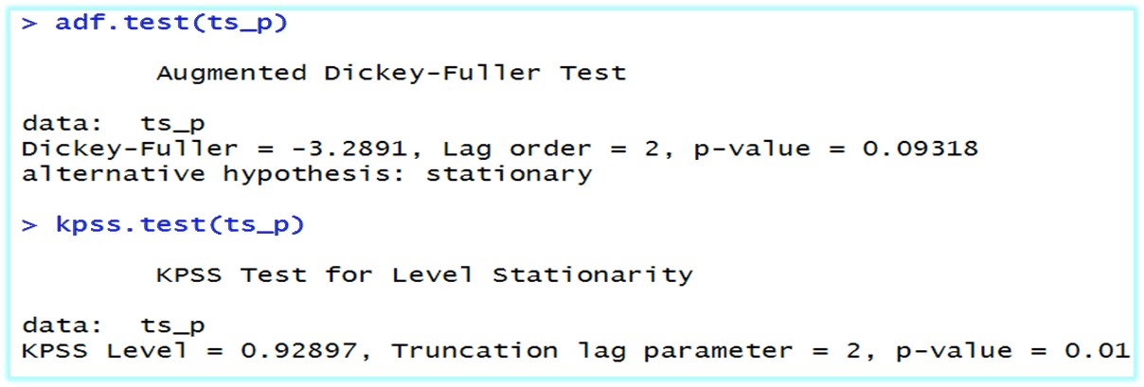

Test Results:
By Stationary Tests:
ADF Test -> Data is not stationary
KPSS Test -> Data is not stationary
Criteria :
If any one test shows stationarity, we can proceed with ARIMA.
Differencing is crucial to make data stationary before fitting ARIMA.

Slide 10
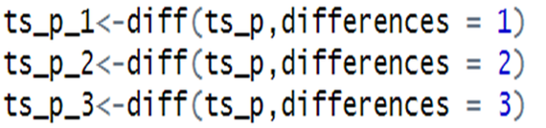
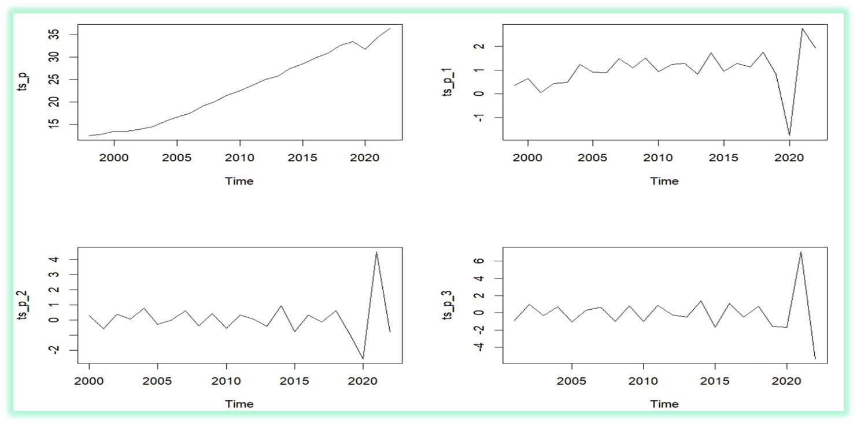
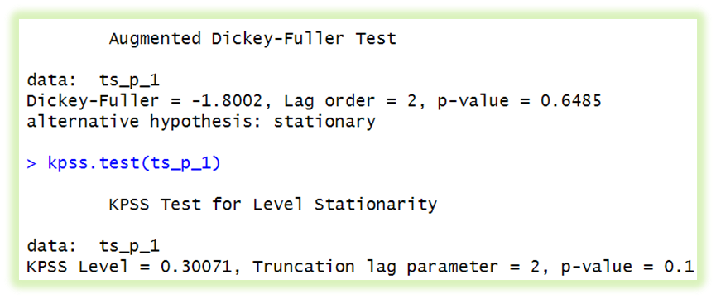
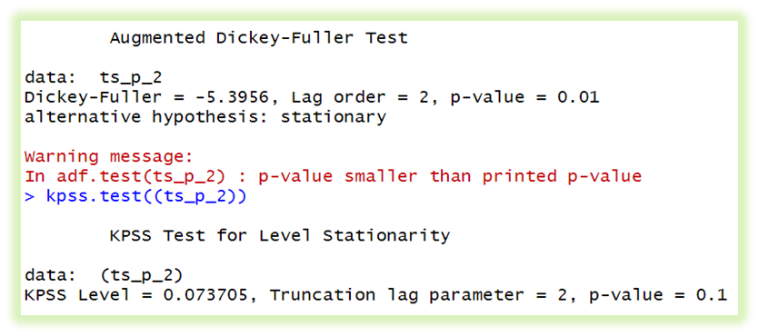
To Make Stationary
Differencing: Transforming Non-Stationary Data into Stationary Time Series
TESTING WITH ADF & KPSS TEST:

Slide 11
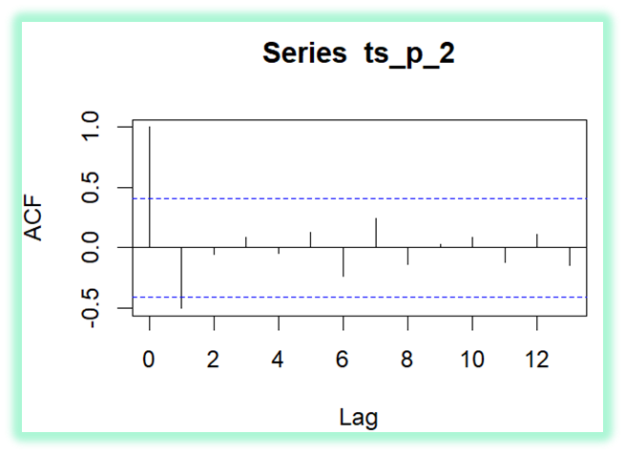
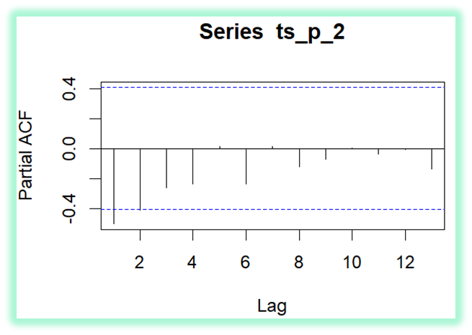

ACF and PACF plots help select the order (p, d, q) for an ARIMA model.
A sharp drop in ACF after lag k and a spike in PACF at lag k indicates an AR(p) component with p = k.
A sharp drop in PACF after lag k and a spike in ACF at lag k suggests an MA(q) component with q = k.
The parameters are interpreted as p = 2 and q = 1.
The AUTO ARIMA function suggests the model ARIMA (2,0,1), confirming the model's applicability.

Slide 12
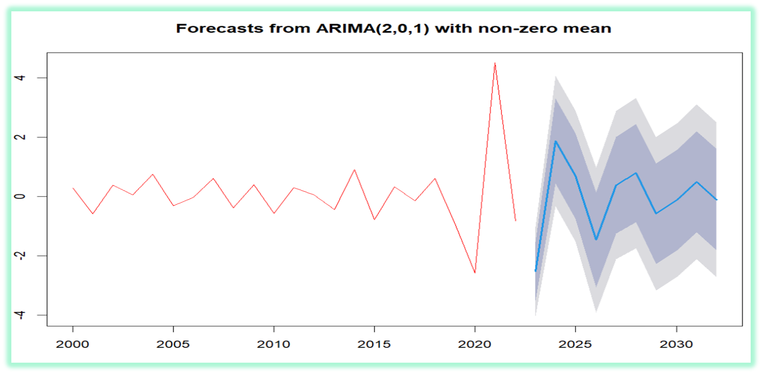
Forecasting The ARIMA Model
(2022 To 2032)

Slide 13
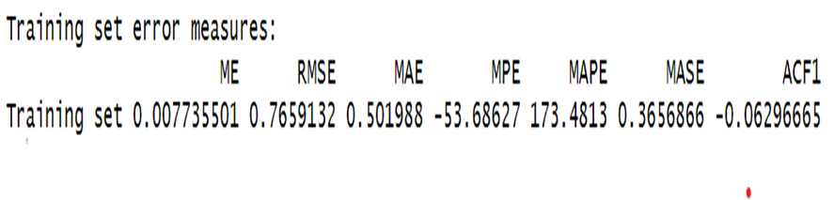
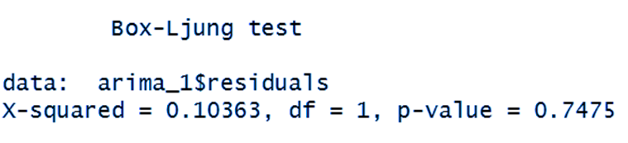
TESTING THE FIT:
TESTING THE MODEL FIT AND COMPARISON WITH ACTUAL DATA
Null Hypothesis (H0): There is no serial correlation in the data, meaning that the autocorrelations at all lags are equal to zero.
Alternative Hypothesis (H1): There is serial correlation in the data, meaning that at least one of the autocorrelations at some lag is not equal to zero
TESTING THE ACCURACY OF PREDICTION
For the training set:
• A low RMSE and MAE indicate that your model is fitting the training data well.
• MASE close to 1 suggests that your model is performing reasonably compared to a naïve model.
For the testing set:
The missing value (NA) for ACF1 suggests that the test set residuals might not exhibit significant autocorrelation.
CONCLUSION:
The Box- L jung test yielded a chi-squared statistic (X-squared) of approximately 0.10363 with 1 degree of freedom and a corresponding p-value of approximately 0.7475. Since the p-value is significantly greater than the commonly used significance level of 0.05, we fail to reject the null hypothesis.
MODEL IS GOOD FIT

Slide 14


Method To Reduce The Electricity Consumption
Reducing electricity consumption is essential for energy efficiency, sustainability, and cost savings. Here are effective strategies to achieve this:
SOLAR PANELS
Upgrade to energy-efficient appliances and LED lighting.
Install smart thermostats.
Encourage energy-saving behaviors and conduct energy audits.
Improve insulation in homes and buildings.
Using solar panels is an excellent way to save electricity consumption and promote renewable energy.

Slide 15


Method To Reduce The Electricity Consumption
WINDMILL
Wind Energy & Conservation:
Windmills generate clean, renewable electricity with no greenhouse gases.
Scalable, cost-effective, and suitable for homes to utility projects.
Complements solar power for reliable day-night supply.
Provides environmental and economic benefits.
Supports a sustainable energy future.
Educate & Encourage Others:
Raise awareness about energy conservation.
Motivate family, friends, and coworkers to adopt saving practices.
Small changes , big impact on reducing consumption & promoting sustainability.

Slide 16






Utilized datasets from Statista.com, for comprehensive information.
Employed R Studio libraries and custom code to access, clean, analyze, and visualize the data, ensuring transparency and reproducibility.
Augmented analysis with supplementary insights from Wikipedia and clearly cited the relevant Wikipedia pages as additional sources of context.
REFERENCES:

Slide 17






THANK YOU !

